Slide 1
Big Data and Modern Database Systems
Dr.U.K.SRIDEVI
Department of Applied Mathematics and Computational Sciences

Slide 2
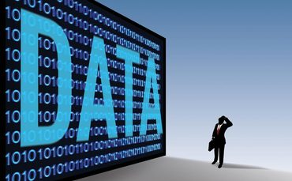
Large-Scale Data Management
Big Data Analytics
Data Science and Analytics
How to manage very large amounts of data and extract value and knowledge from them

Slide 3
Introduction to Big Data
What is Big Data?
What makes data, “Big” Data?

Slide 4
What is “big data”?
"Big Data are high-volume, high-velocity, and/or high-variety information assets that require new forms of processing to enable enhanced decision making, insight discovery and process optimization” (Gartner 2012)

Slide 5
Why is “big data” a “big deal”?
Walmart handles more than 1 million customer transactions every hour, which is imported into databases estimated to contain more than 2.5 petabytes of data
Facebook handles 40 billion photos from its user base.
Falcon Credit Card Fraud Detection System protects 2.1 billion active accounts world-wide
Biomedical computation like decoding human Genome & personalized medicine

Slide 6
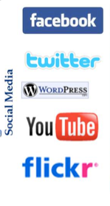
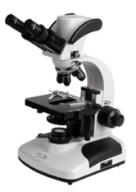

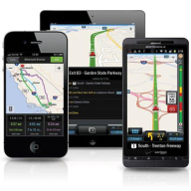
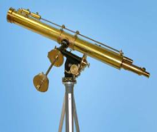

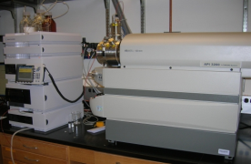
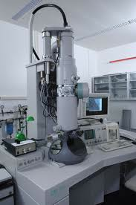
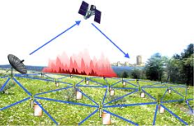

Who’s Generating Big Data
Mobile devices
(tracking all objects all the time)
Social media and networks
(all of us are generating data)
Scientific instruments
(collecting all sorts of data)
Sensor technology and networks
(measuring all kinds of data)
The progress and innovation is no longer hindered by the ability to collect data
But, by the ability to manage, analyze, summarize, visualize, and discover knowledge from the collected data in a timely manner and in a scalable fashion

Slide 7
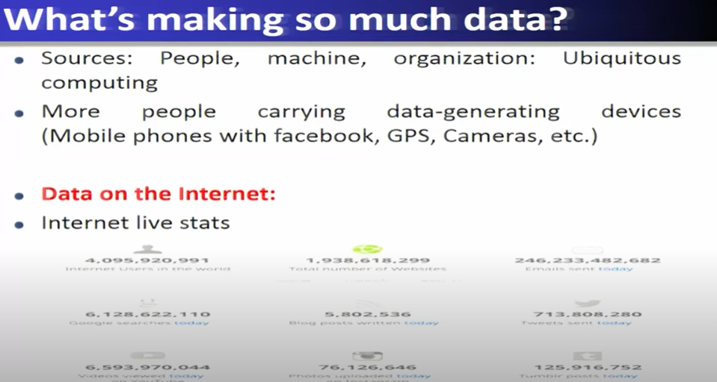

Slide 8
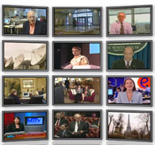
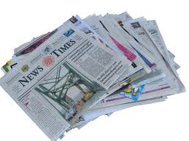
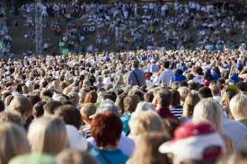

The Model Has Changed…
The Model of Generating/Consuming Data has Changed
Old Model: Few companies are generating data, all others are consuming data
New Model: all of us are generating data, and all of us are consuming data

Slide 9
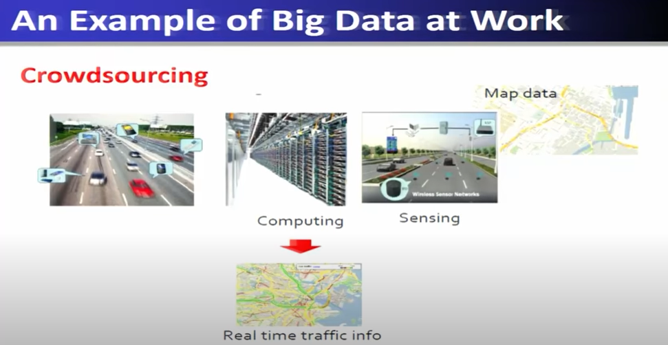

Slide 10
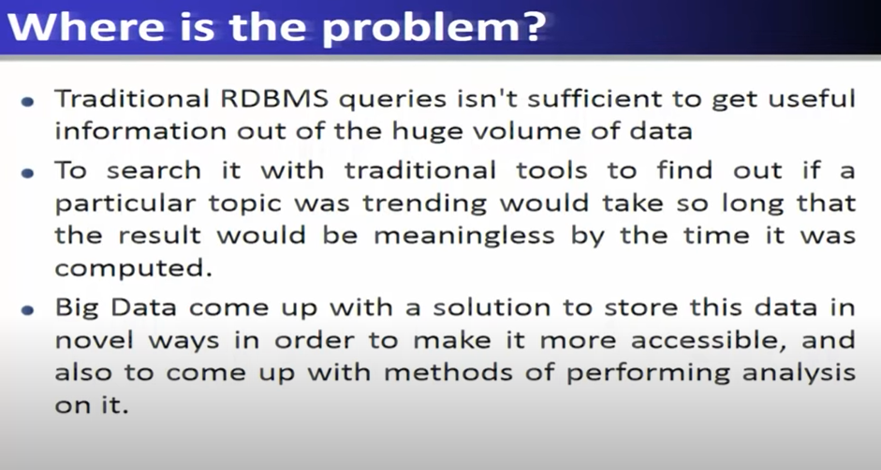

Slide 11
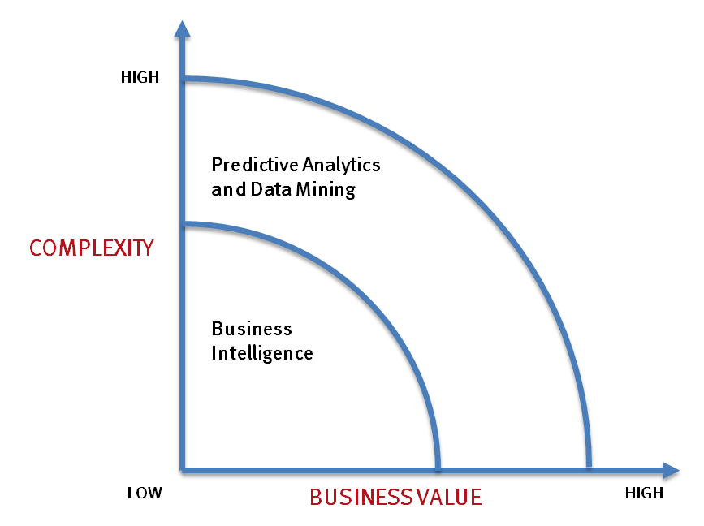
What’s driving Big Data
- Optimizations and predictive analytics
- Complex statistical analysis
- All types of data, and many sources
- Very large datasets
- More of a real-time
- Ad-hoc querying and reporting
- Data mining techniques
- Structured data, typical sources
- Small to mid-size datasets

Slide 12
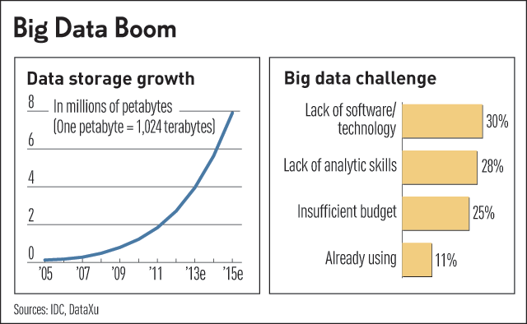
Challenges in Handling Big Data
The Bottleneck is in technology
New architecture, algorithms, techniques are needed
Also in technical skills
Experts in using the new technology and dealing with big data

Slide 13
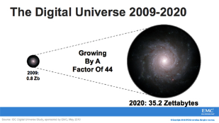
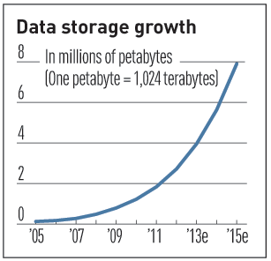

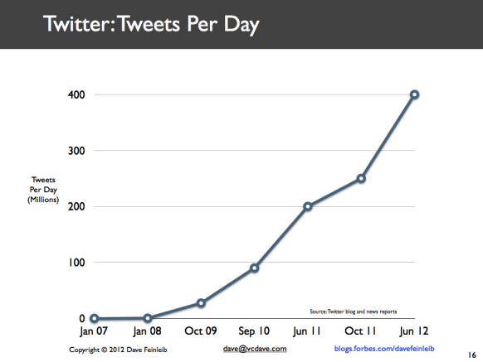
Characteristics of Big Data: 1-Scale (Volume)
Data Volume
44x increase from 2009- 2020
From 0.8 zettabytes to 35zb
Data volume is increasing exponentially
Exponential increase in collected/generated data

Slide 14
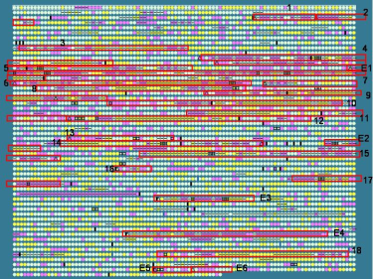
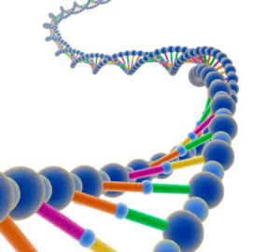
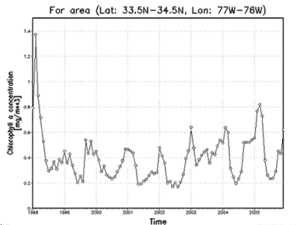
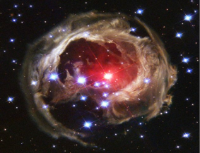
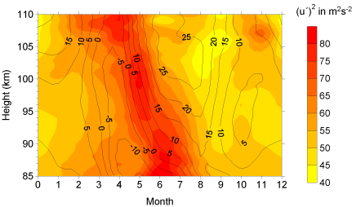
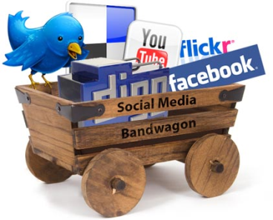
Characteristics of Big Data: 2-Complexity (Varity)
Various formats, types, and structures
Text, numerical, images, audio, video, sequences, time series, social media data, multi-dim arrays, etc…
Static data vs. streaming data
A single application can be generating/collecting many types of data
To extract knowledge🡺 all these types of data need to linked together

Slide 15

Characteristics of Big Data: 3-Speed (Velocity)
Data is begin generated fast and need to be processed fast
Online Data Analytics
Late decisions 🡺 missing opportunities
Examples
E-Promotions: Based on your current location, your purchase history, what you like 🡺 send promotions right now for store next to you
Healthcare monitoring: sensors monitoring your activities and body 🡺 any abnormal measurements require immediate reaction

Slide 16
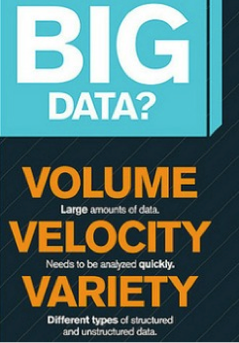

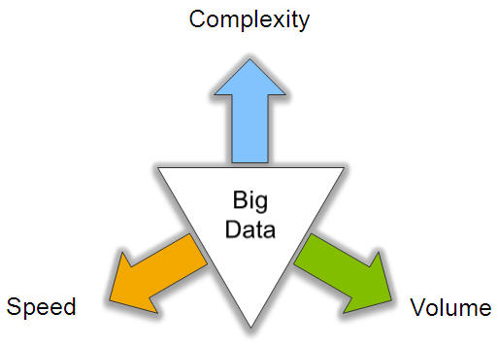
Big Data: 3V’s

Slide 17
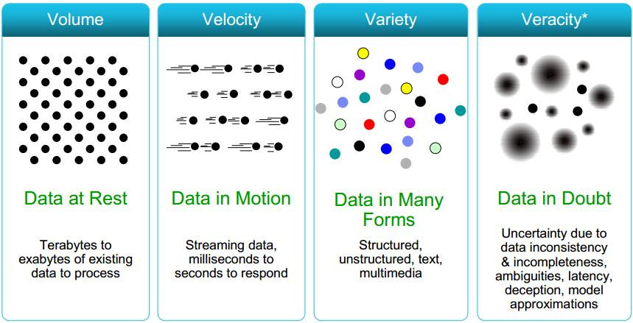
Some Make it 4V’s

Slide 18
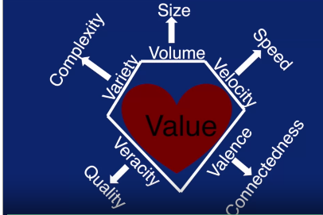
Characteristics of Big Data

Slide 19
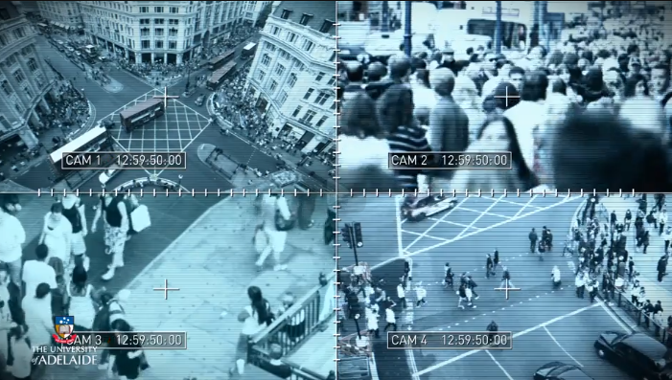

Slide 20
V’s of Big Data
Volume: Volume is a huge amount of data
Velocity:
Velocity refers to the high speed of accumulation of data.
Variety:
It refers to nature of data that is structured, semi-structured and unstructured data.
Veracity:
It refers to inconsistencies and uncertainty in data, that is data which is available can sometimes get messy and quality and accuracy are difficult to control.
Value:
The bulk of Data having no Value is of no good to the company, unless you turn it into something useful. Data in itself is of no use or importance but it needs to be converted into something valuable to extract Information
Variability
Variability is different from variety. A coffee shop may offer 6 different blends of coffee, but if you get the same blend every day and it tastes different every day, that is variability.
Valence :
Refers to the connectedness of big data
Visualization:
Reporting

Slide 21
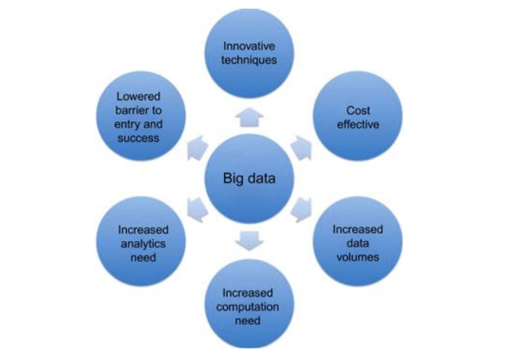
What made Big data needed?

Slide 22
Lifecycle of Data: 4 “A”s
Scattered
Data
Aggregation
Integrated
Data
Acquisition
Analysis
Log data
Knowledge
Application

Slide 23
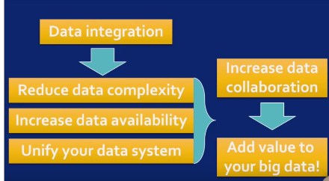

Slide 24


Computational View of Big Data
Data Visualization
Data Access
Data Analysis
Data Understanding
Data Integration
Formatting, Cleaning
Storage
Data

Slide 25
Example of Analysis: Predictive Modeling
Group M1
Group M2
 | Movie 1 | Movie 2 | … | Movie m
User1 | 3.5 | 4 |  | 5
User2 | 5 | 1
…
User n | 2 | 1 |  | 4
Group U1
=?
Group U2
Does user2 like movie m?
What rating is user2 likely going to give movie m?
(Binary) Classification
Regression

Slide 26
What Technology Do We Have
For Big Data ??

Slide 27
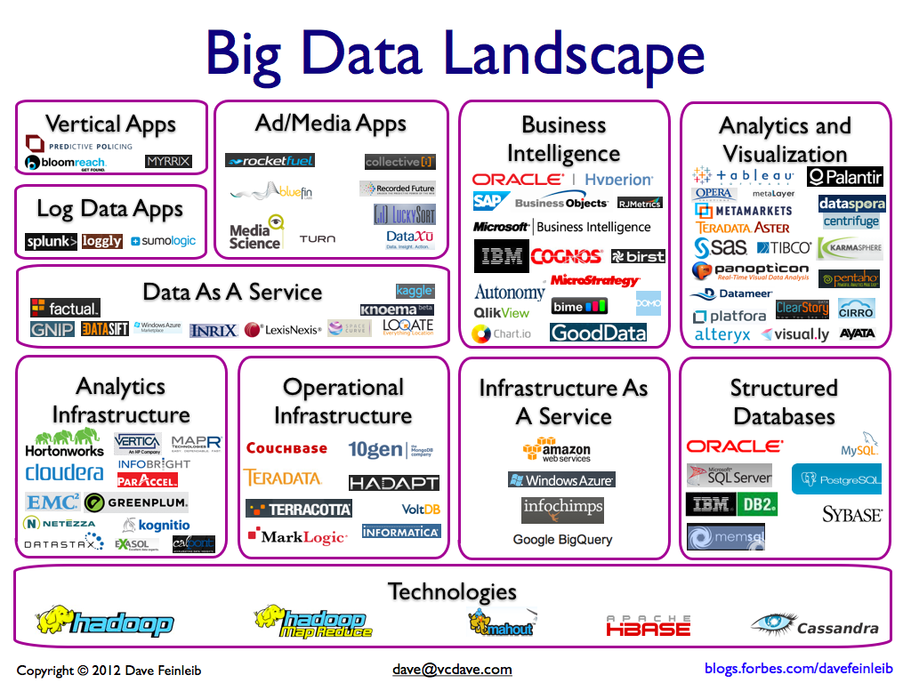

Slide 28
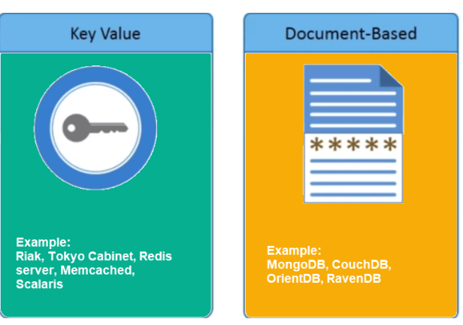
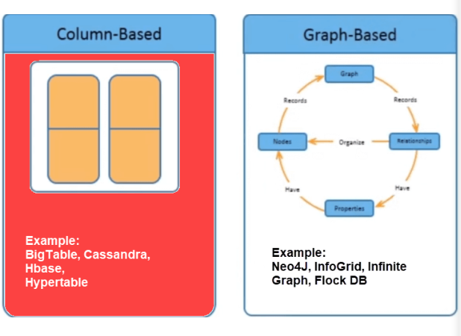

Slide 29
Focus
Big data Technologies
Streaming Big Data Analytics
Big Data Visualization
Big Data and Solutions
Focusing on building a full-spectrum understanding of the latest Big Data Analytics technologies and using them to build real industry real-world solutions

